Slide 1
STATG019 – Selected Topics in Statistics 2015 Lecture 4
Kernel Methods for Big Data
Dr Franz J. Király

Slide 2
Course organization
In-Course-Assessment
Two take-home ICA, one on kernels, one on point processes
Each counts 50% towards your final grade
Handing out: no.1 on Feb 9, no.2 on Mar 23 (on moodle) Submission: no.1 on Mar 4, no.2 on Apr 29 (via moodle/TurnitIn)
Submission details for ICA no.1 will be announced
Tutorials and/or practical sessions
Thursday, 11am - 1pm , February 26
Tutorial will be mainly on mathematical concepts and the exercises
Also a bit of R and programming issues, if we have the time
Thursday, 11am - 1pm , February 12?
R programming, kernlab, help on getting started with the ICA?

Slide 3
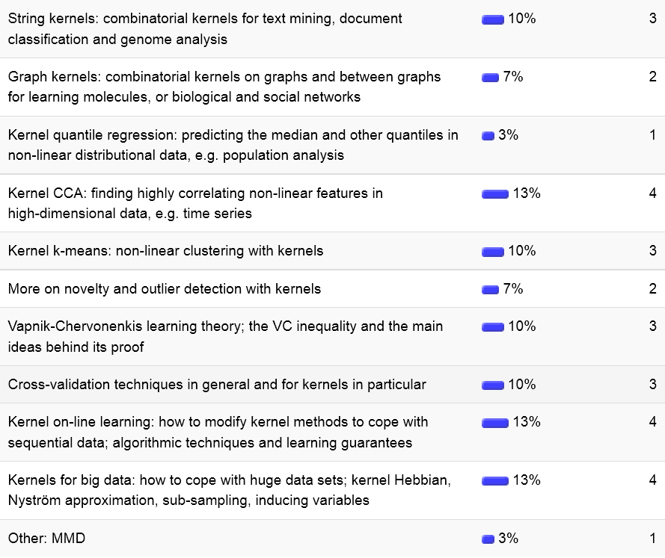
Today
Arthur is doing MMD!

Slide 4






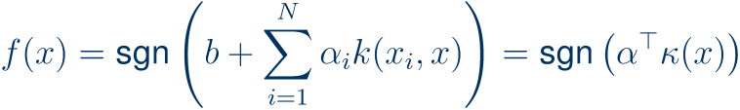

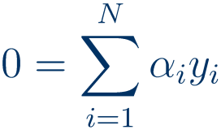

Kernel learning in the presence of BIG DATA
Kernel ridge regression:
Kernel PCA:
Kernel SVM:
s.t.
Idea no.1: low-rank approximation
no.2: iterative/incremental methods
yields low-dimensional feature vectors
directly applicable to on-line setting

Slide 5
Low-Rank Approximation

Slide 6




The Pseudo-inverse and row-span projectors
Definition (Penrose-Moore-pseudoinverse):
Proposition:
Existence:
Uniqueness:
Remark:
in the middle: (pseudo-)inverse of Gram matrix!

Slide 7



The Nyström approximation
idea in the context of integral equations
(E. Nyström, 1928; )
Remark:
Main idea:
Rewriting
Proposition (deterministic approximation):
(i)
(ii)
(by Weyl’s theorem)
(iii)
(use positive semi-definiteness)
Theorem (Kumar et al, NIPS 2009):
(one example for probabilistic approximation)
Remark:
(more precisely: use existence of Cholesky decomposition)
so statements are fine for arbitrary kernels

Slide 8














Speeding up kernels with Nytröm
Nytsröm-approximation:
Idea for speed-up:
time cost
Vanilla:
compute eigenpairs of
kPCA
Nyström:
compute left singular pairs of
Vanilla:
SVM
Nyström:
so
Vanilla:
compute
then
Nyström:
Ridge regression
observe, going backwards in the derivation of ridge regression
alternative: the Woodbury identity (later today)
so compute

Slide 9



Sparse Gaussian processes regression
Main assumptions:
“inducing”
prediction
“inducing”
Derivation of posterior distribution:
By assumption:
equivalent to GP regression with covariance function
mean and variance efficiently computable in analogy to ridge regression

Slide 10


Williams, Seeger (2001): uniformly random sub-sample
will be fine due to
and
Pros: works very often, fast
Cons: slow on degenerate/clustered data
Fine et al, Bach et al (2001/2): Greedy for approximation (unsupervised)
Bach et al (2005): Greedy for goodness of prediction (supervised)
due to factorization method called “incomplete Cholesky decomposition”
Pros: informed, thus converges quickly
Cons: greedy
optimal
Snelson et al (2006): Bayesian inference on inducing variables
Pros: Bayesian
Cons: Bayesian
Kiraly et al (2014):
Theorem:
Pros: independent of data degeneracies
Cons: slower convergence (constants)
An overview can also be found in Kumar (2012): Sampling methods for the Nyström method

Slide 11
Iterative kernel methods

Slide 12




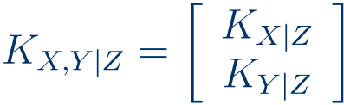

Low-rank updates for inversion
Proposition (Sherman, Morrison, Woodbury):
“the Woodbury formula”
(despite Sherman & Morrison being earlier)
Proof:
(or use the SVD argument)
On-line learning update for ridge regression/Gaussian processes:
old coefficients:
where
new coeff’s:
where
and where
SMW-formula yields
Similar updates can be derived for posterior variance
Note that repeated updating may lead to cumulative time cost of

Slide 13





The (kernel) Hebbian algorithm
or Sanger’s rule (1989)
(for neural networks)
Goal:
Idea (Sanger): sequential update with
(rows=eigenvectors)
where
Sanger’s rule combines gradient descent (Oja’s rule) and Gram-Schmidt
Theorem (Oja, Sanger, 1982/1989): converges under very mild conditions
Kernelization:
by a search in the feature span of the data:
(compare representer thm)
Theorem (Kim et al, 2003): converges under very mild conditions
Günter et al, 2007: even faster (empirically) for a good

Slide 14



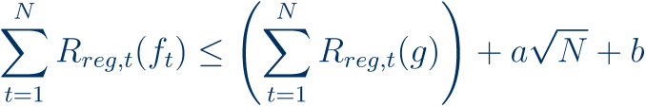
Stochastic gradient descent on regularized risk
Setting:
Idea (various): sequential update of
so
Observation:
Theorem (Kivinen et al, 2004):
(in the RKHS)
then

Slide 15
And there is much more…
… but not in kernlab
Some methods are implemented in
scikit, Shogun, LibSVM, etc

Slide 16
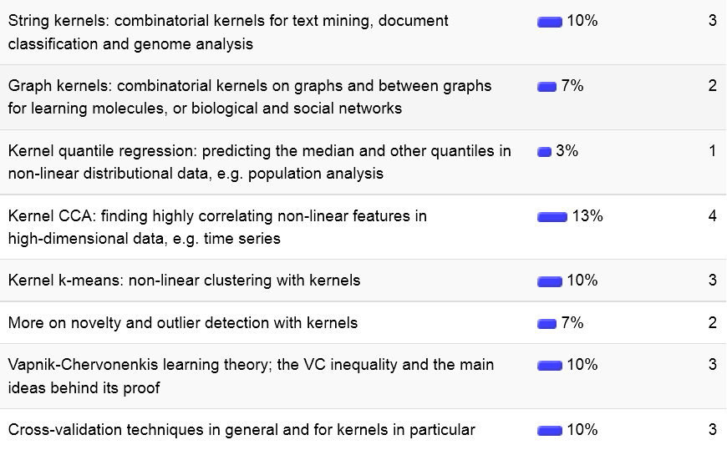
Next week:
?

